Slide 1
PRESENTATION
ON
RADAR MONITORING SYSTEM
by Shohag, Tasmin

Slide 2
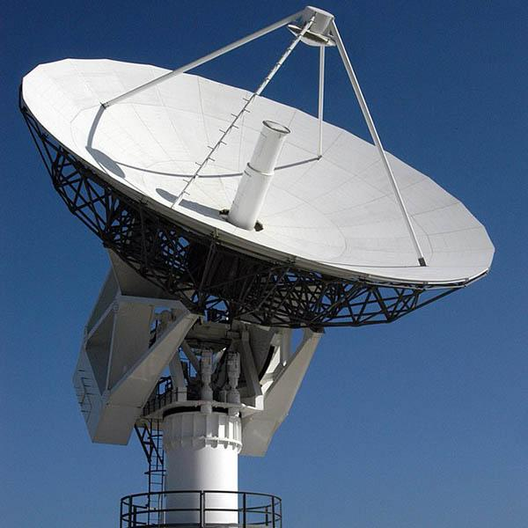
WHAT IS A RADAR SYSTEM
Radar, electromagnetic sensor used for detecting, locating, tracking, and recognizing objects of various kinds at considerable distances
The basic working principle of all the radio systems is the same. The radio uses a transmitter to produce an electromagnetic signal that is then propagated into the space using an antenna. When this signal strikes an object, it gets reflected back, and this reflected signal is known to be the echo signal.
Ultrasonic radar uses ultrasonic waves for obstacle detection.

Slide 3
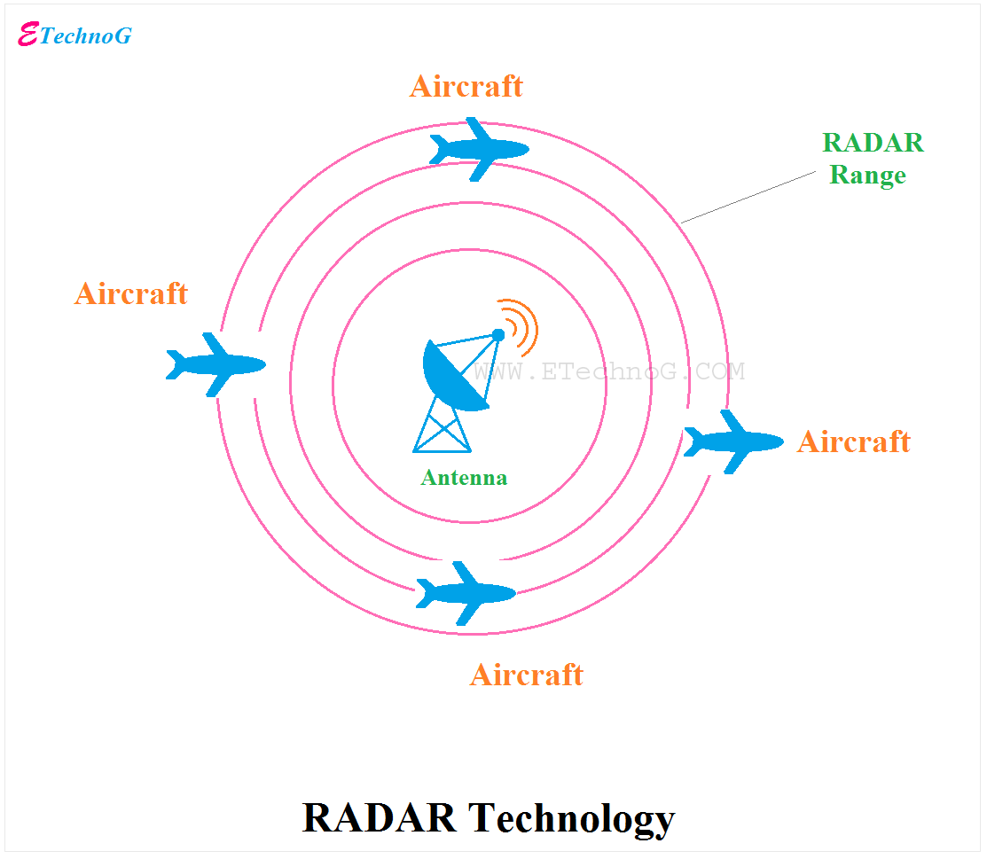
APPLICATION OF RADAR SYSTEM
Military
Remote sensing
Ship security
Satellites
Air traffic control
Law enforcement and highway security
Miscellaneous application

Slide 4
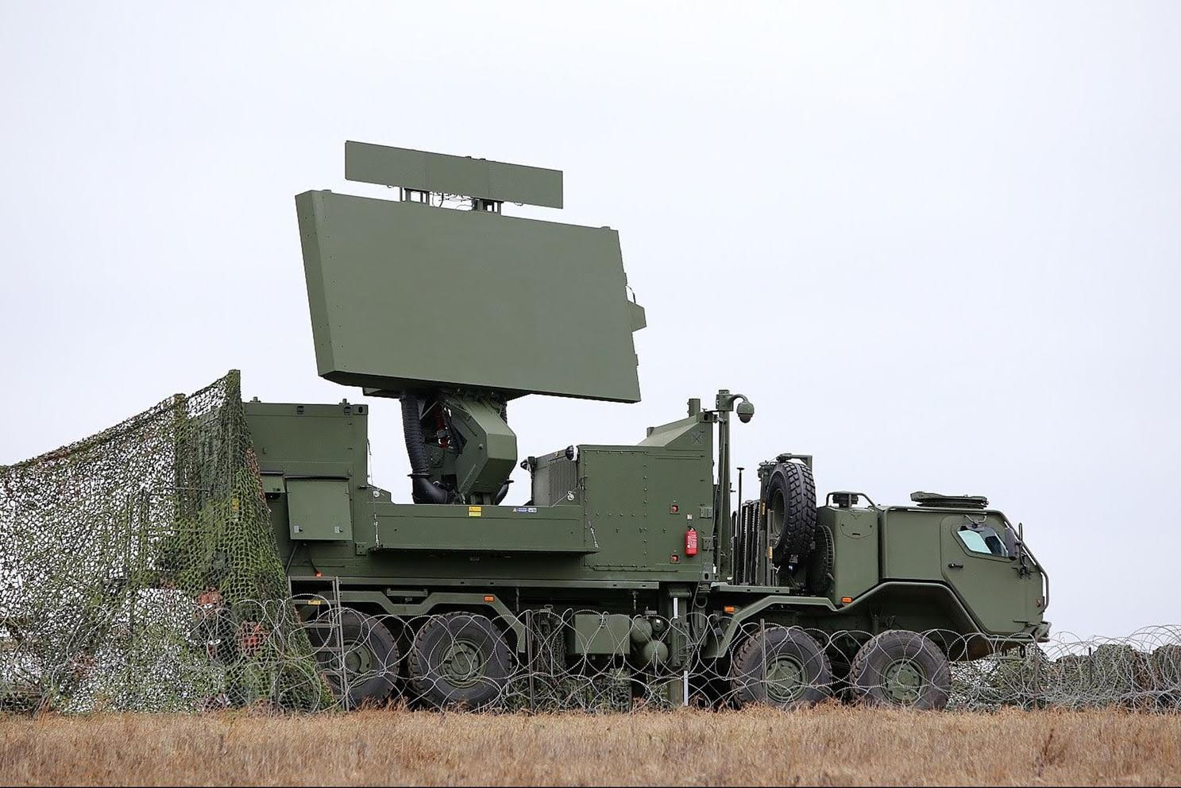
MILITARY RADAR SYSTEM
Surveillance is the monitoring of behavior, activities, or other changing information for the purpose of influencing, managing, or protecting people
It’s challenging to develop a complete independent system that will automatically recognize, tract and destroy the incoming object in predefined area under surveillance which can also work in adverse environment conditions where it is hard for a human soldier to fight with enemy. Entry restricted area such a line of control need to be safe from enemies.

Slide 5
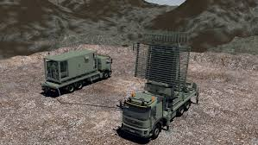
MILITARY APPLICATION
Air defence system, offensive missiles and other weapons
Target detection, target tracking and weapon control
Tracks the targets, directs the weapon to and intercept and assess the effectiveness of engagement
Ground and air surveillance

Slide 6
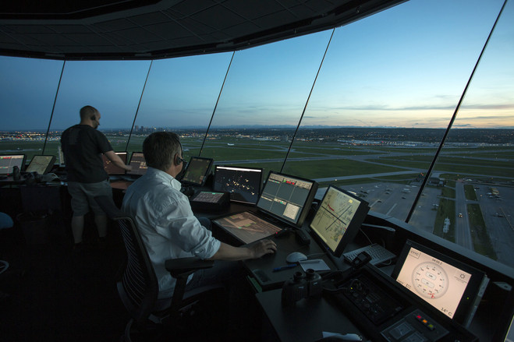
AIR TRAFFIC CONTROL
Ground vehicular traffic and aircraft taxing.
Mapping of regions of rain in vicinity of airports and weather
Used to safely control air traffic in vicinity of the airports

Slide 7
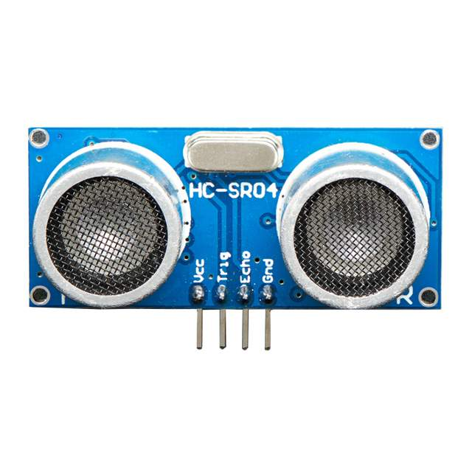
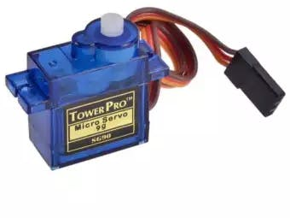
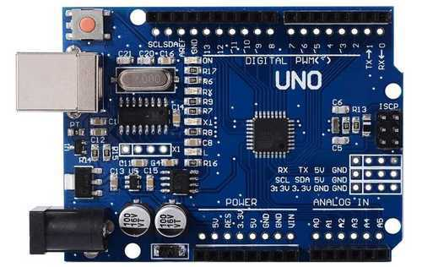
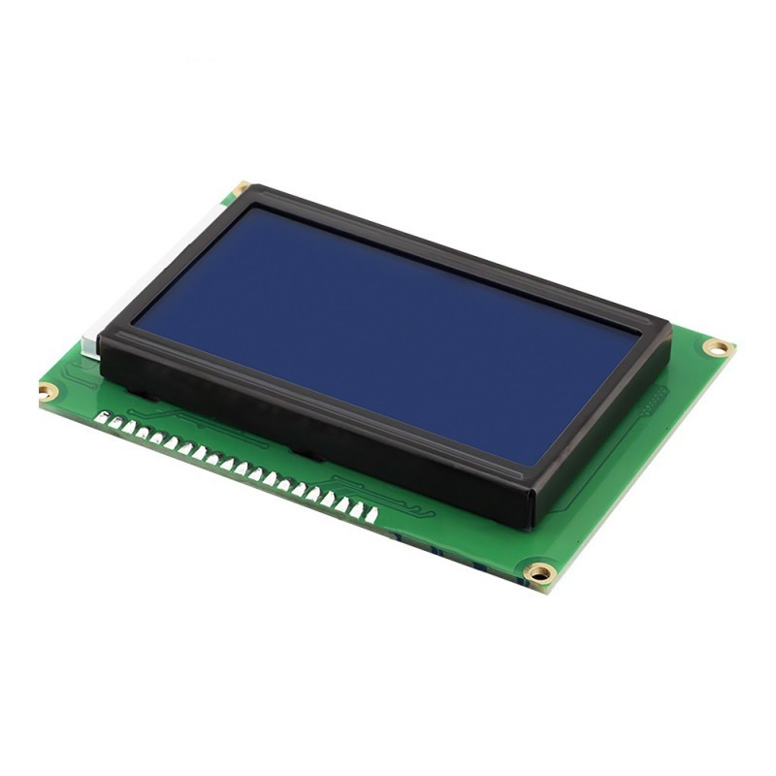
COMPONENT
UNO
Ultrasonic
SERVO MOTOR
LCD DISPLAY

Slide 8
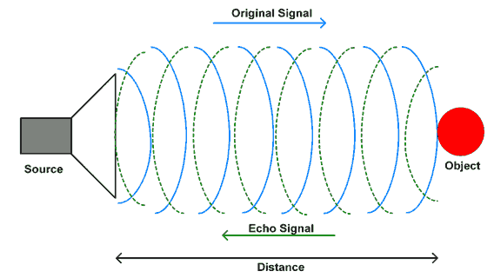
ULTRASONIC SENSOR
Ultrasonic sensors can measure distance and detect the presence of an object without making physical contact.
Three different properties of the received echo pulse may be evaluated for different sensing purposes.
1. Time of flight 2. Doppler shift 3. Amplitude attenuation
Ultrasonic ranging module HCSR04 provides 2 cm - 200 cm non-contract measurement function, the ranging accuracy can reach to 3 mm. The modules includes ultrasonic transmitter, receiver and control circuit

Slide 9
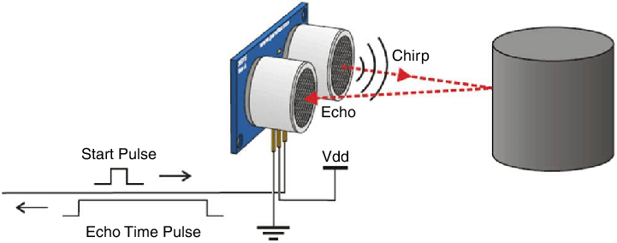
ULTRASONIC SENSOR
Ultrasonic sensors emit short, high-frequency sound pulses at regular intervals. These propagate in the air at the velocity of sound. If they strike an object, then they are reflected back as echo signals to the sensor, which itself computers the distance to the target based on the time-span between emitting the signal and receiving the echo

Slide 10
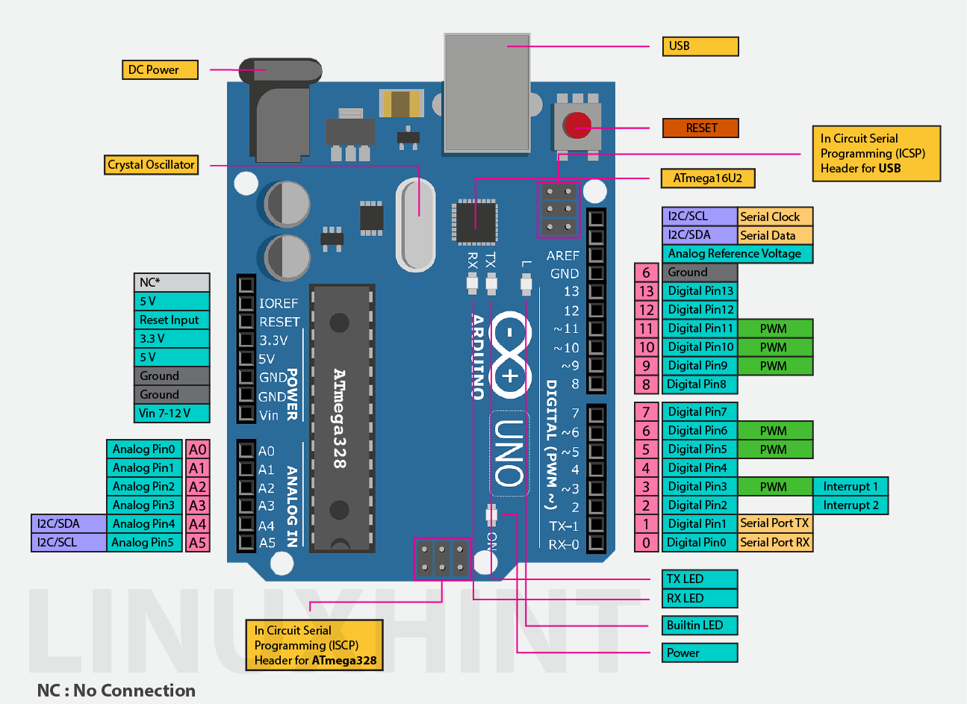
ARDUINO UNO
The Arduino UNO is a microcontroller board based on the ATmega328.
It has 14 digital Input/Output pins (of which 6 can be used as PWM outputs), 6 Analog inputs, a 16MHz crystal oscillation, USB connection, a power jack, an ICSP header and a reset button.
It contains everything needed to support the microcontroller; simply connect it to computer with a USB cable or power it with a AC-to-DC adapter or battery to get started.

Slide 11
SERVO MOTOR
A servomotor is a rotary actuator that allows for precise control of angular position, velocity and acceleration.
It consists of a suitable motor coupled to a sensor for position feedback.
Servo motors are used in applications such as robotics, CNC, Machinery or automated manufacturing

Slide 12
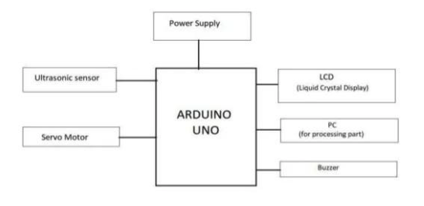
BLOCK DIAGRAM

Slide 13
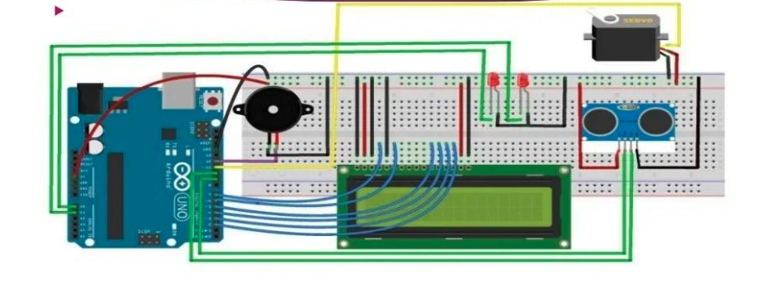
CIRCUIT DIAGRAM

Slide 14
DATA COLLECTION
Data is collected using ultrasonic sensor and servo motor
Ultrasonic sensor is used to measure the time elapsed between the transmitter and receiver wave
Servo moto movies at specified angle i.e.
This gives the ultrasonic sensor the given to move along as specified by user.

Slide 15
CALCULATION
All the calculations are done by the microcontroller ARDUINO UNO
Data is sent to arduino by sensor and motor
Distance of obstacle is calculated using formula
Distance = (time * 340) / 2 0 degree temperature sound velocity = 332 m/s 1 degree increase temperature velocity increase = 0.6 m/s 33 degree = 332 + (6 * 33) x = ((3518) * x) / 10 ^ 6
The calculated distance and angle is sent for the display of result

Slide 16
OUTPUT
The calculated distance and measured angle is displayed on LCD
The above two are also printed on the serial monitor which is read by processing code to display the visual effect of radar on screen
Green Line shows the absence of any object in range while red line shows the presence of particular object
Buzzer in our project makes an alarming sound when objects is found to be in range of less than 10cm of ultrasonic sensor.

Slide 17
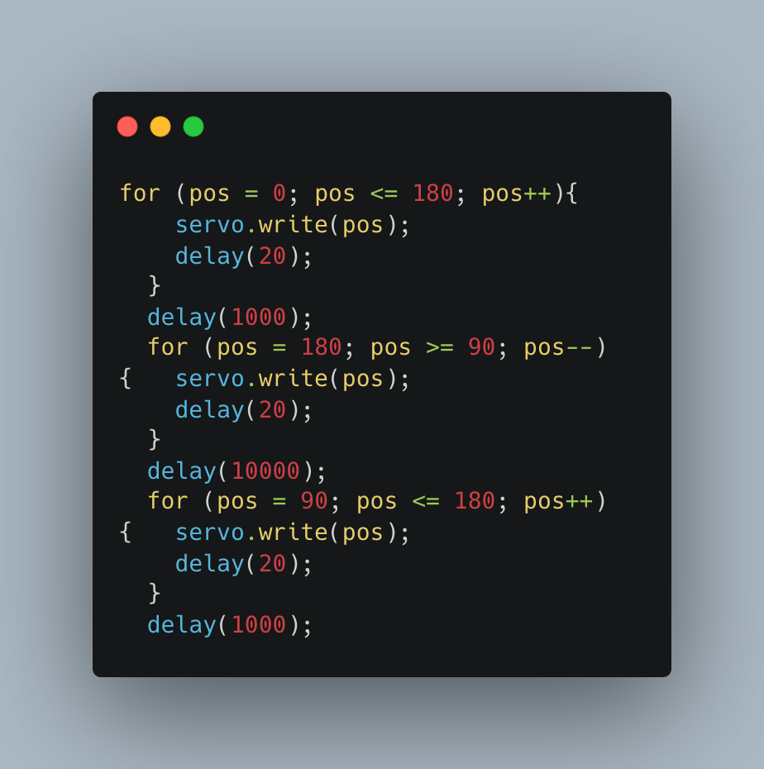
CODE SNIPPETS
Measuring angle

Slide 18
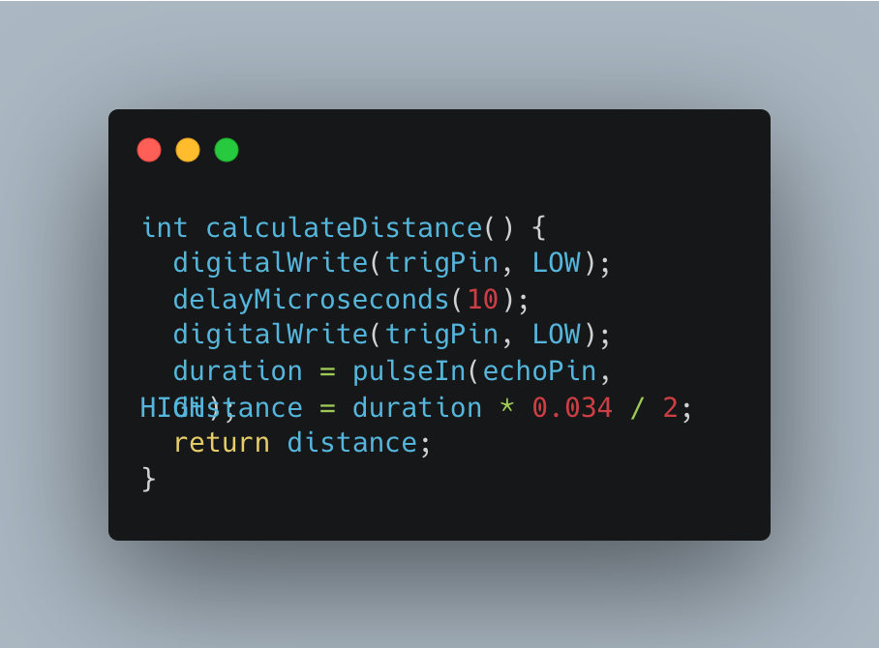
CODE SNIPPETS
Distance Calculation

Slide 19
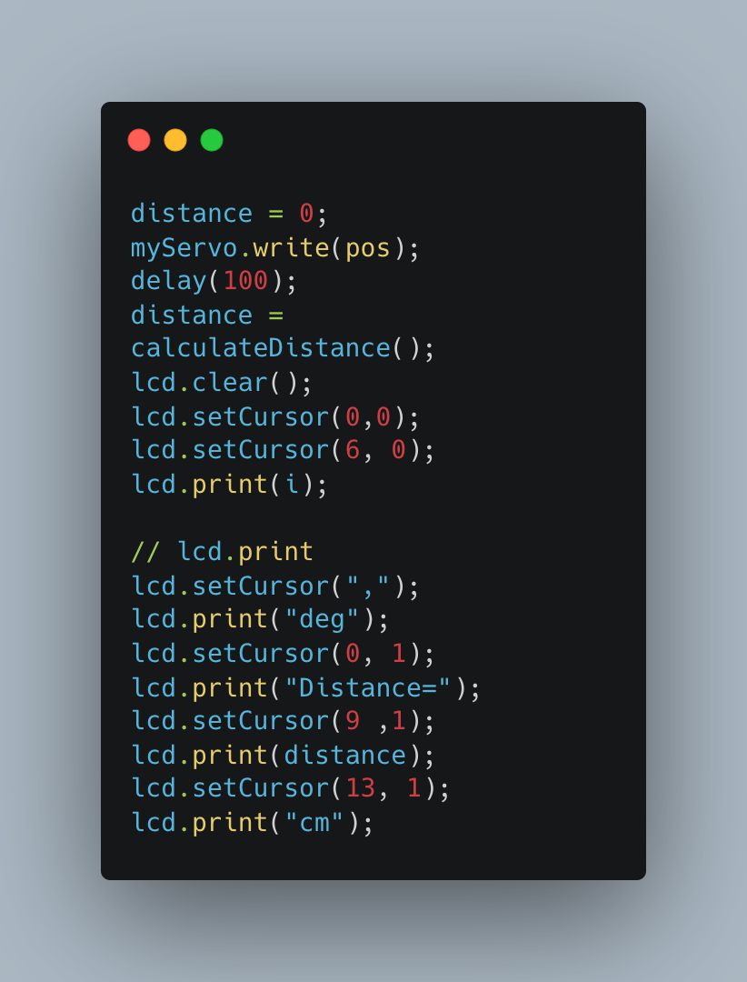
CODE SNIPPETS
LCD DISPLAY ALL THE INFORMATION

Slide 20
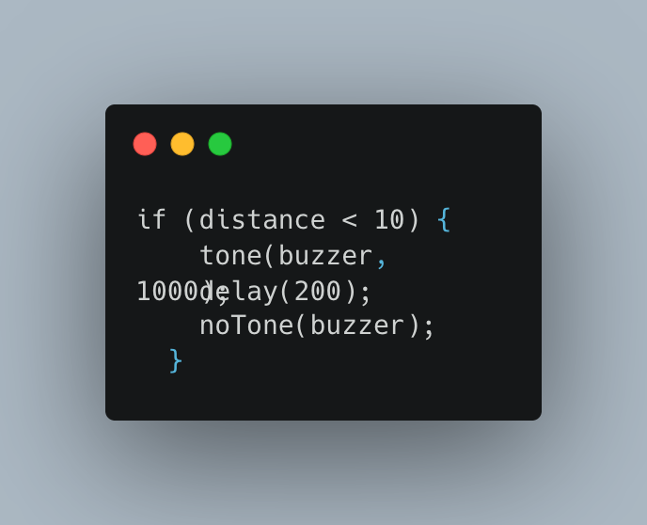
CODE SNIPPETS
Buzzer sound for unauthenticated object

Slide 21
ADVANTAGE
The Radar system can be used in a stationary mode as well as moving mode.
The accuracy of the Radar system is very high.
The Radar system can be used in a very large area for the measurement and detection purpose.
Using the Radar system, distance, angular position, speed, shape, etc can be measured together.
The Radar system can work through the insulating material. It is a great advantage of Radar.
A Radar system can detect and measure more than one object together and gives very accurate data.

Slide 22


Thank you
FOR
YOUR
ATTENTION

